Slide 1
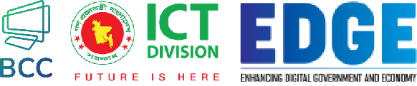

Arif Istiake Sunny
Session 1: Python Basics​
Senior Software Engineer (AI)
Brain Station 23 PLC
​
Mobile: 01732009493​
Email: sunny1509006@gmail.com​

Slide 2
Contents
01
Overview of Python and Its role in backend development
02
Setting up the development environment (VS Code)
03
Basic Syntax, Variables, Data type and Operators
04
Control Structures (If-else, Match)
05
Password Strength Checker

Slide 3
Overview of Python and Its role in backend development
01

Slide 4




What is Python?
Versatile Programming Language
Python is a versatile, high-level programming language used for a wide range of applications.
Interpreted and Interactive
Python code is interpreted, allowing for immediate feedback and interactive development.
Easy to Learn and Use
Python's simple and readable syntax makes it an accessible language for beginners.

Slide 5

Why Python?
Easy to learn & read
Powerful & flexible
Widely used in:
Huge community support
Backend Development
Data Science
Automation
APIs & Web Development

Slide 6

Why is Python good for Backend?
Frameworks like Django & Flask
Easy API development
Integration with Databases
Clean Syntax → Faster Development
Popular Companies using Python:
Instagram, Spotify, Dropbox, Netflix

Slide 7
Setting up the development environment (VSCode)
02

Slide 8
Tools You Need
Python Installation → python.org
IDE → Visual Studio Code (VSCode)
Recommended Extensions:
Python Extension

Slide 9
Basic syntax, variables, data types, and operators
03

Slide 10
Control structures (if-else, Match)
04

Slide 11
Password Strength Checker
05

Slide 12
Thank You

Slide 13
Dictionaries
Flexible Data Structures
Dictionaries store key-value pairs, allowing for efficient data retrieval.
Mutable and Ordered
Dictionaries are mutable, and their order can be controlled.
Diverse Applications
Dictionaries are useful for a wide range of tasks, from data analysis to web development.

